Slide 1
CUSTOMER CHURN ANALYSIS
Telco Customer Churn Dataset — Business Analytics Presentation
Data Analytics Internship Programme | AnalystLab Africa
Prepared by: Lisemanyane Paul Mporoane

Slide 2
BUSINESS UNDERSTANDING
Why Churn Matters
Customer churn — customers discontinuing service — directly erodes recurring revenue. In telecom, where switching providers is low-friction, retaining an existing customer is far cheaper than acquiring a new one.
THE SCALE OF THE PROBLEM
26.54%
KEY BUSINESS QUESTIONS
of customers have churned
1
Does contract type influence churn?
1,869
5,174
2
Are fibre-optic customers more likely to churn?
3
Does payment method correlate with churn?
customers churned
customers retained
4
How do tenure & charges differ by churn status?
More than 1 in 4 customers left — a material, recurring revenue loss if unaddressed.
2

Slide 3
DATASET INSPECTION
A Clean, Complete Dataset
7,043
21
0
11
Customer Records
Columns
Duplicate Rows
Hidden Missing Values Found
WHAT WE FOUND
Standard null-checks showed 0 missing values, but "TotalCharges" was stored as text and hid 11 blank entries.
All 11 affected rows had zero tenure (brand-new customers with no billing history yet) — a logical gap, not an error.
TotalCharges was converted to numeric and the gaps filled with 0; every customerID is unique with no duplicate records.
3

Slide 4
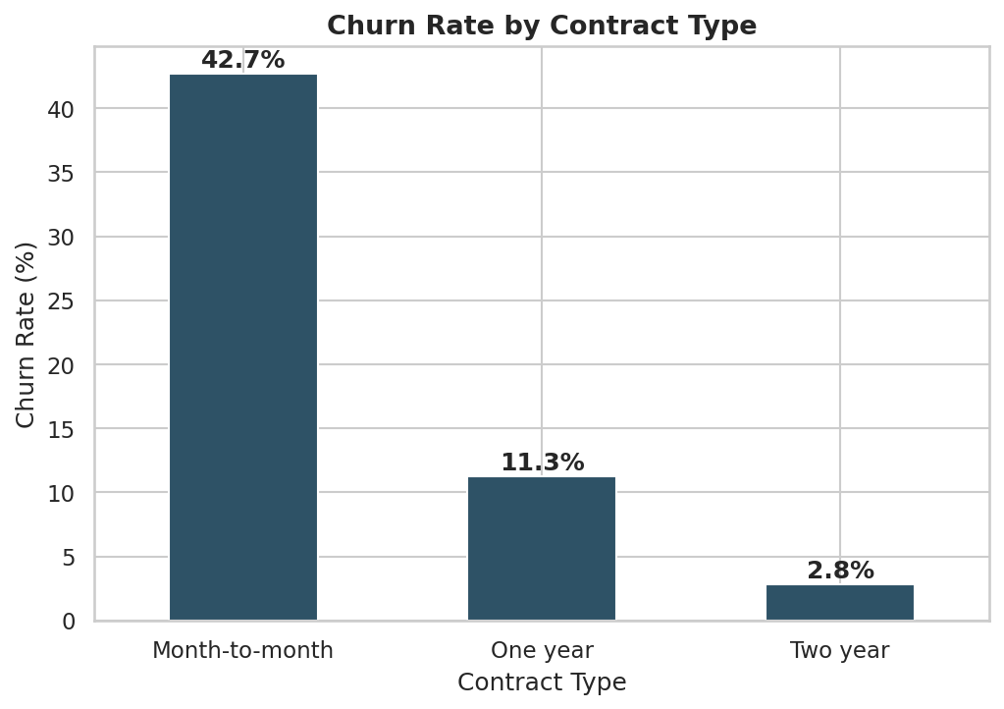
BUSINESS DATA ANALYSIS
Contract Length Is the #1 Churn Driver
42.7%
churn rate for month-to-month customers
vs. just 2.8% for two-year contracts — a 15x difference
55% of all customers are on month-to-month plans — the exact segment most likely to churn — putting a majority of recurring revenue at structural risk.
4

Slide 5
BUSINESS DATA ANALYSIS
The Premium Product Is Leaking Customers
41.9%
churn rate for fibre-optic subscribers
more than double DSL's 19.0% rate
Despite being the higher-bandwidth, higher-margin product, fibre optic has the weakest retention — pointing to possible reliability, price, or competitive pressure issues.
5

Slide 6
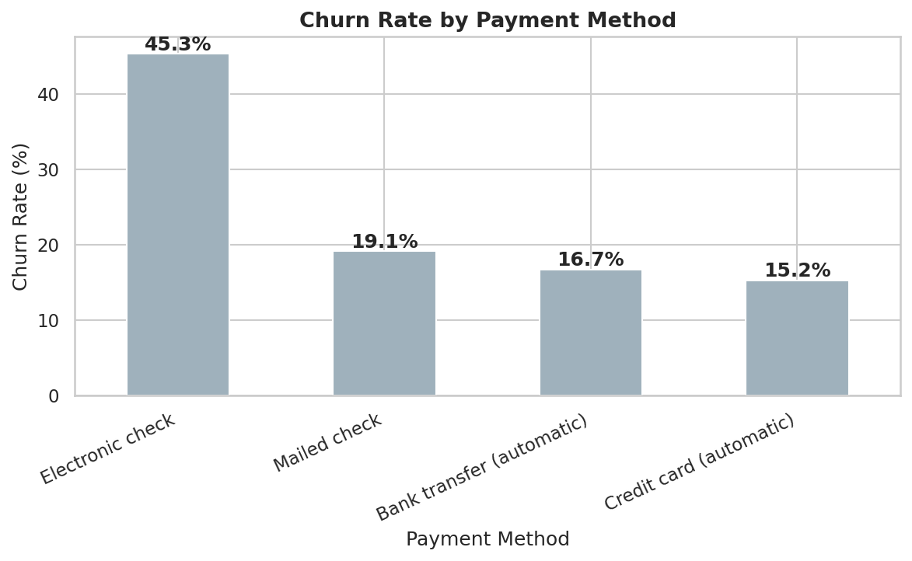
BUSINESS DATA ANALYSIS
Manual Payments Signal Disengagement
45.3%
churn rate for electronic check payers
~3x the rate of automatic payment methods
Automatic bank transfer and credit card customers churn at 15-17% — automatic payment appears to be a proxy for higher commitment.
6

Slide 7
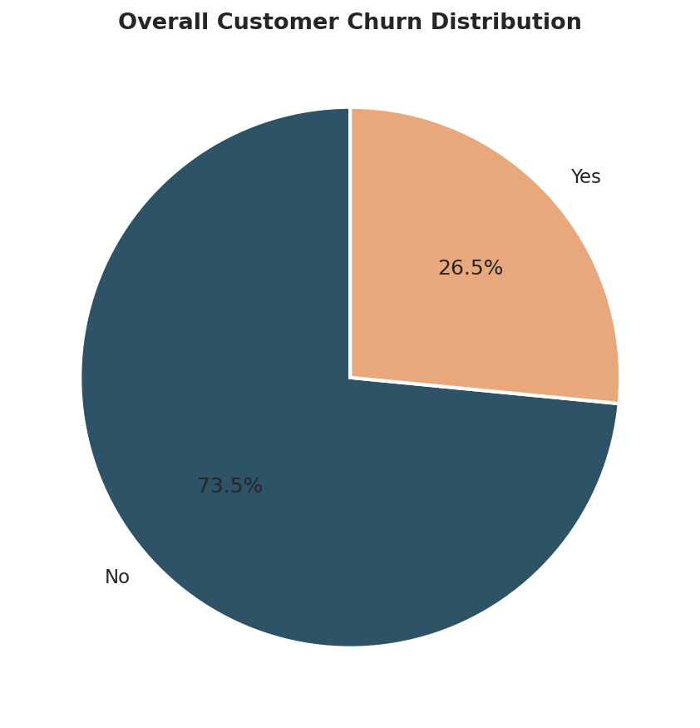
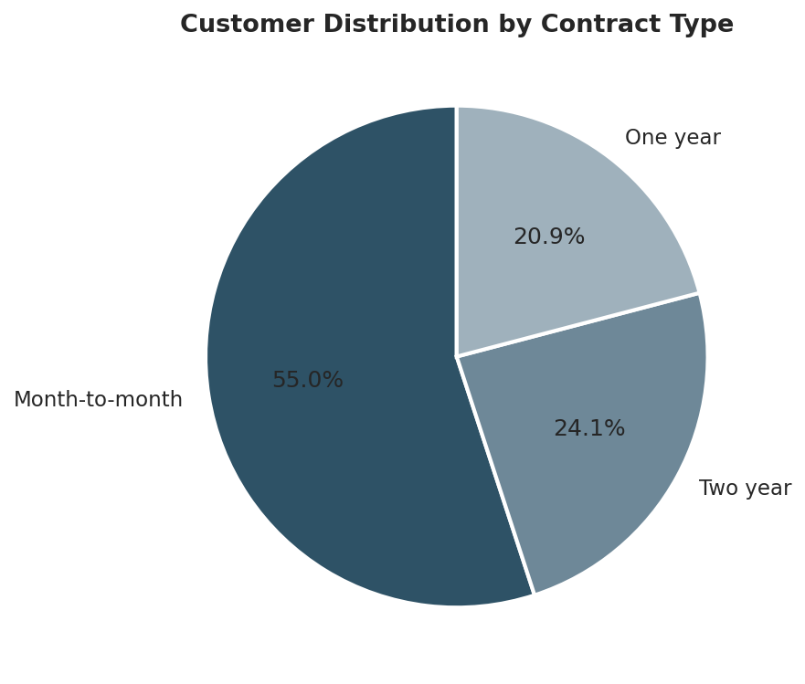
BUSINESS DATA ANALYSIS
Composition of the Customer Base
26.54% of customers have churned overall.
55% of customers are on month-to-month plans — the same segment with the highest churn rate.
7

Slide 8
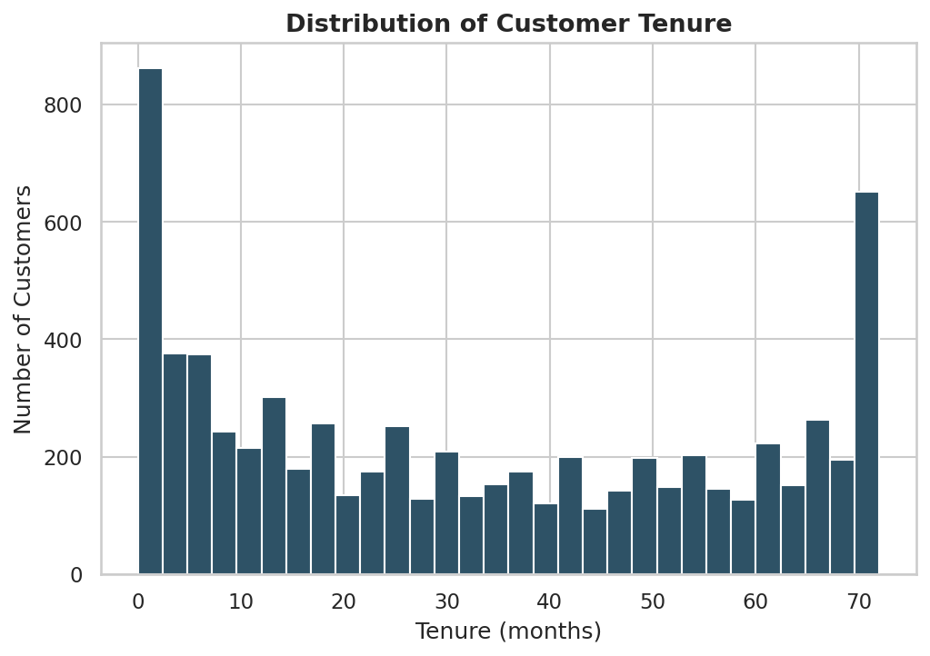
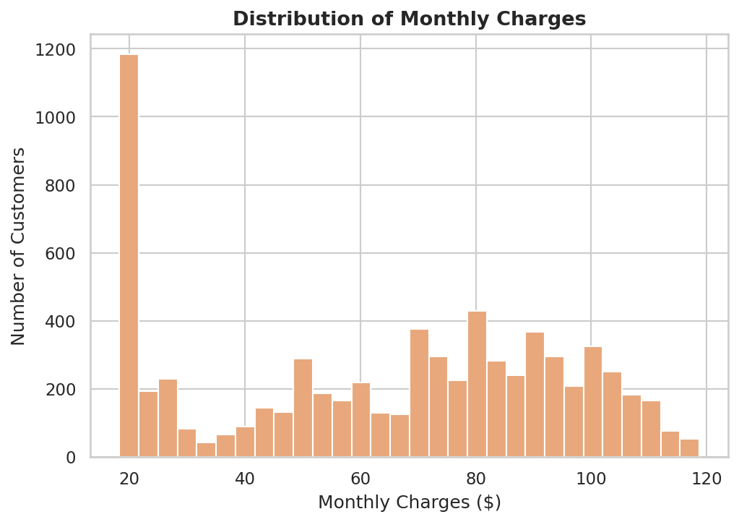
BUSINESS DATA ANALYSIS
Tenure & Spend: Two Distinct Populations
Tenure is bimodal — many brand-new customers and a second cluster of loyal, long-term customers near 72 months, with fewer in between.
Monthly charges cluster around $20-30 (phone-only) and $65-100 (bundled fibre/internet) — reflecting distinct product tiers.
8

Slide 9
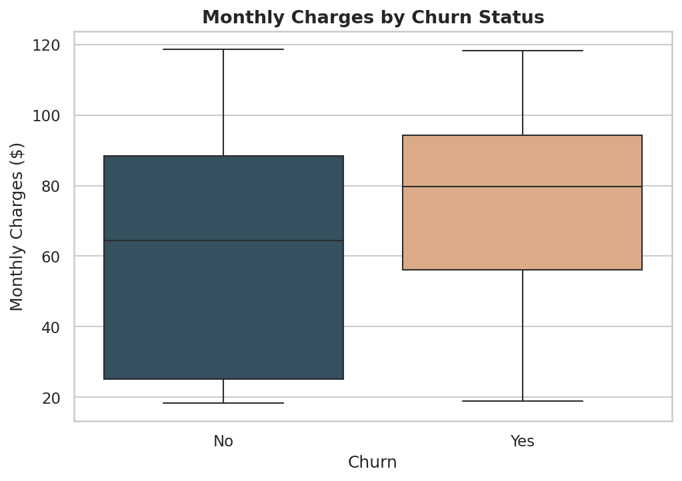
BUSINESS DATA ANALYSIS
Higher Spend, Higher Risk
Churned customers have a higher median monthly charge ($79.65) than retained ones ($64.43), reinforcing that higher-paying customers — often fibre, month-to-month subscribers — are the most flight-prone segment.
9

Slide 10
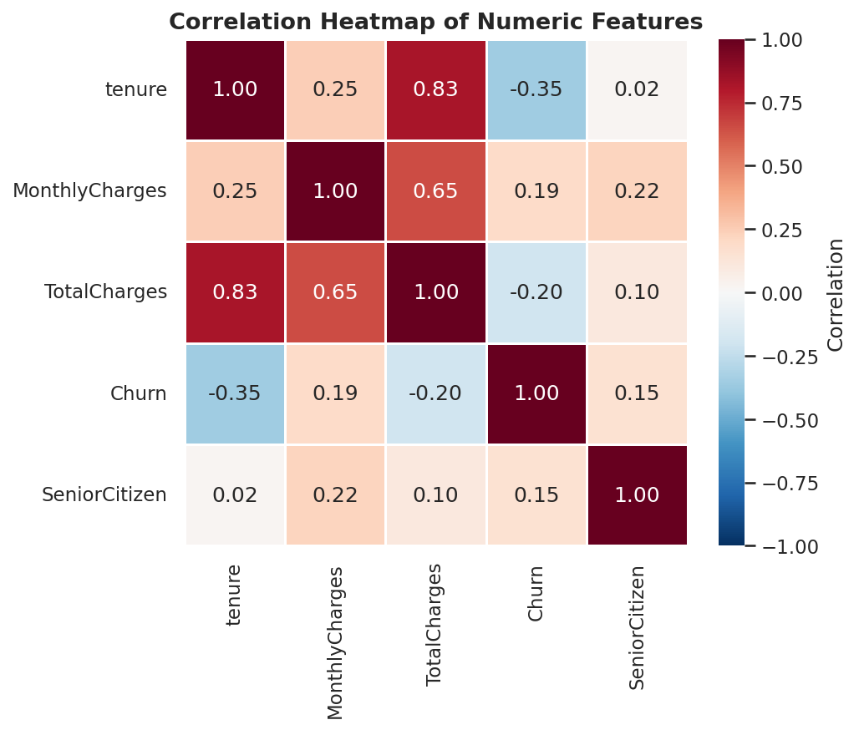
BUSINESS DATA ANALYSIS
What Correlates Most With Churn?
Tenure has the strongest correlation with churn (-0.35) — longer-tenured customers churn far less. MonthlyCharges is positively correlated with churn (0.19), while TotalCharges correlates strongly with tenure (0.83), since total spend accumulates over time.
10

Slide 11
KEY INSIGHTS
Five Patterns Behind the Churn
1
Contract length is the dominant driver — month-to-month churn is ~15x the two-year rate.
2
Fibre-optic customers are disproportionately at risk, with the highest churn of any internet tier (41.9%).
3
Manual payment methods signal disengagement — electronic check churns ~3x automatic payments.
4
Tenure and churn are strongly inversely related — the first year is the highest-risk period.
5
Senior citizens churn at nearly double the rate of non-seniors (41.7% vs. 23.6%).
11

Slide 12
BUSINESS INSIGHTS
Risks vs. Opportunities
BUSINESS RISKS
BUSINESS OPPORTUNITIES
—
Revenue concentration: month-to-month customers are >55% of the base and churn most.
—
Contract migration: incentivise annual/two-year contracts to cut churn sharply.
—
Premium product risk: fibre optic, likely the highest-margin service, retains worst.
—
Payment conversion: move electronic-check users to automatic payment methods.
—
Early-life attrition: heavy churn in year one erodes acquisition ROI.
—
Segment-specific offers: target fibre-optic and senior-citizen customers directly.
12

Slide 13
BUSINESS RECOMMENDATIONS
Six Actions to Reduce Churn
01
02
Launch a contract upgrade campaign for month-to-month customers.
Investigate fibre-optic service quality and pricing.
03
04
Promote automatic payment enrolment over electronic check.
Strengthen new-customer onboarding in the first 90 days.
05
06
Build a senior-citizen retention track with simplified plans.
Deploy a churn-risk scoring model for proactive retention.
13

Slide 14
Churn is concentrated, not random.
Month-to-month contracts, fibre-optic subscribers, electronic-check payers, new customers, and senior citizens are the clear, addressable drivers of churn. Targeted retention investment here should outperform a blanket, company-wide effort.
Thank you — Questions & Discussion

